Slide 1
House price prediction
By:- Laxmikant Mukkawar
Student ID:- 168554210

Slide 2
AGENDA
Introduction
Data Exploration
Data Cleaning
Exploratory Data Analysis
Correlation
Data Preparation
Predictive Models
Conclusion

Slide 3
INTRODUCTION
The client has provided us with a housing dataset so that we can analyze the data and predict the housing prices as well as analyze which attribute has the more impact on sale price
No of observations – 300
No of attributes – 32
Target Variable - SalePrice

Slide 4
Data exploration
Number of observations - 300
Number of attributes – 31
Numercial attribute – 24
Categorical Variables – 8
Columns containing nulls - Garage_Type_2, Masonry_Veneer, Lot_Shape_2

Slide 5
Data cleaning
Removing Null Values
Observations After removing null values – 266
Removing columns with no use and empty columns
Columns after cleaning – 29

Slide 6
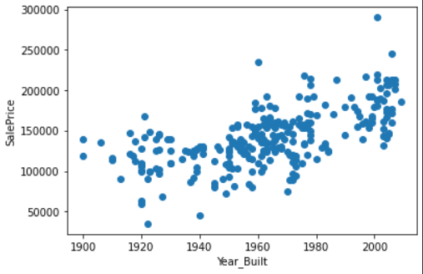
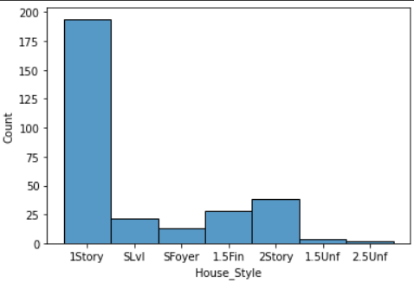
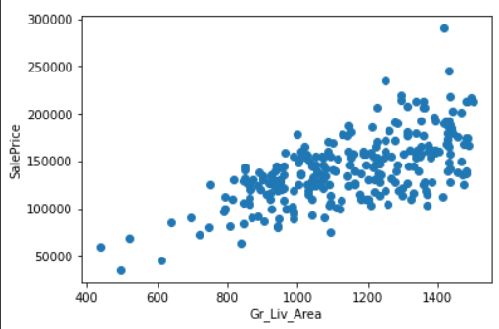
Exploratory data analysis
Sales Price Positively related with Year built
Understanding which house style is most popular
Living area is highly positively related to Sale Price

Slide 7
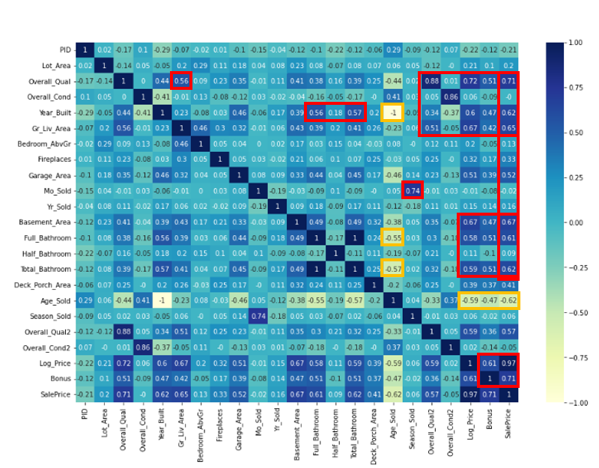
Correlation

Slide 8
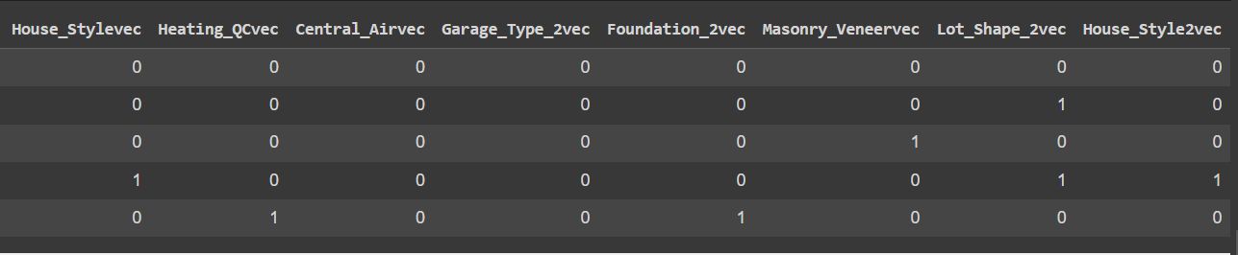
Data Preparation
Converting categorical variables to numerical variables
Spliting of data set into training and test data sets

Slide 9
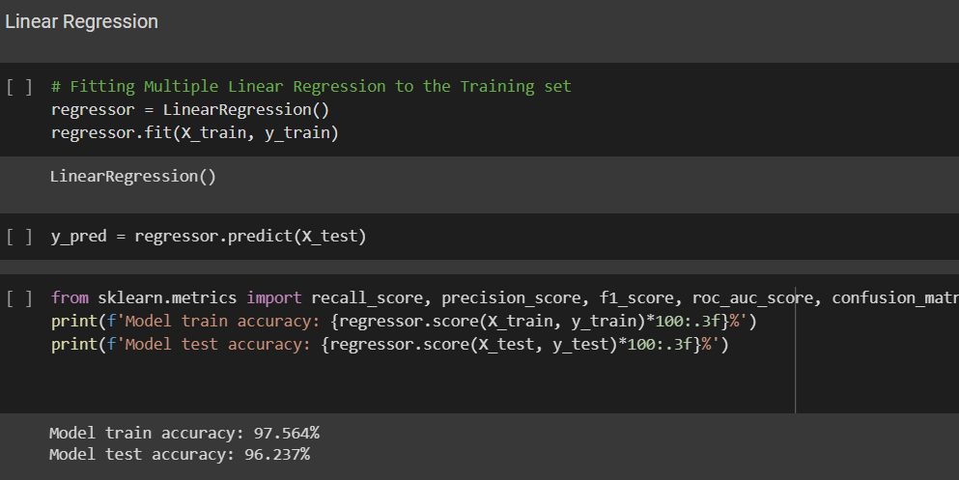
Predictive models
Linear Regression:
Accuracy on the training dataset and train dataset is 97.5% and 96.5% respectively.

Slide 10
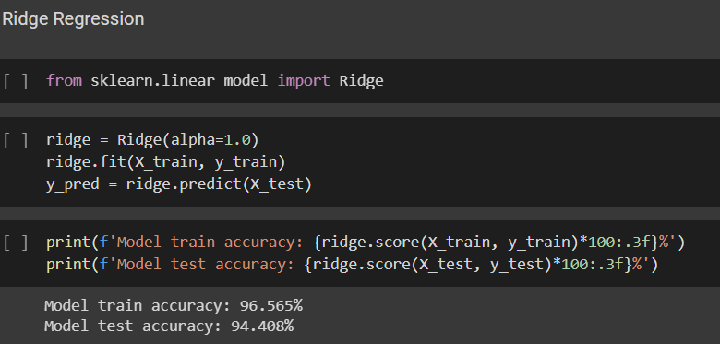
Predictive models
Ridge Regression:
Accuracy on the training dataset and train dataset is 96.5% and 94.4% respectively.

Slide 11
Conclusion And recommendation
Multilinear Regression model is the most efficient model as its accuracy is 96.5%
Attributes to focus on – Living area, Overall quality
​Attributes that can be overlooked – Overall Condition, Fireplace.
Focus should be on maintaining the house since the age of the house is directly related to the sale price. As age increases sale price decreases.

Slide 12
THANK YOU
Presentation by: Laxmikant Mukkawar

